Slide 1
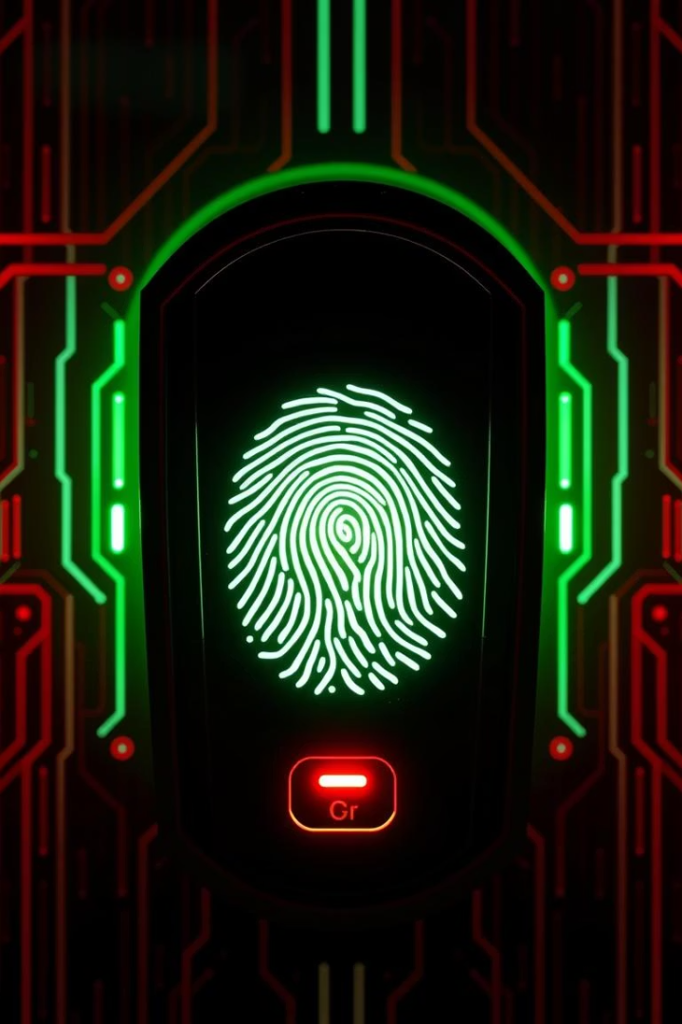
SIM Card & Fingerprint Fraud in Pakistan
This presentation will shed light on the alarming rise of SIM card and fingerprint fraud in Pakistan, a sophisticated scam that exploits the country's mandatory biometric SIM registration system. We will explore how fraudsters deceive unsuspecting individuals into providing their fingerprints for illicit activities, enabling widespread financial fraud. Understanding the mechanics of this scam, the inherent risks associated with compromised biometric data, and crucial protective measures is essential for every citizen.
Mansoor Bukhari

Slide 2
How the SIM Card Fraud Works
Deceptive Offers
Fingerprint Collection
Targeting Vulnerable Groups
Fraudsters approach unsuspecting individuals, often in public places or remote areas, offering "free SIM cards" or other attractive incentives. These offers are a deceptive tactic to gain trust and facilitate the collection of personal data.
Under the guise of mandatory biometric registration for the "free SIM," victims are asked to provide their fingerprints on a biometric device. The device, often legitimate, is used by the fraudsters for their illicit purposes.
The scam disproportionately targets vulnerable populations, including the elderly, less educated, or those in rural areas with limited awareness of such schemes. Their lack of digital literacy makes them easy prey for these sophisticated fraudsters.

Slide 3



Exploiting Biometric Registration
Mandatory Biometric Verification
CNIC Linkage
Exploiting Loopholes
The CNIC is the cornerstone of identification in Pakistan, with all official services and accounts linked to it. Fraudsters leverage this linkage, understanding that a SIM activated under a victim's CNIC provides a gateway to their digital identity.
Despite stringent regulations, fraudsters exploit loopholes in the system or the ignorance of individuals to illegally activate SIM cards. These SIMs, though registered to the victim, are controlled by the fraudsters, becoming tools for various illicit activities.
Since 2009, Pakistan has mandated biometric verification for all new SIM card activations. This system links each SIM card directly to the user's CNIC (Computerized National Identity Card) through their fingerprints, intended to prevent fraudulent activities.

Slide 4




Activating Fraudulent Accounts
SIM Activation with Victim's CNIC
Using the fraudulently obtained fingerprints, the scam artists activate new SIM cards. These SIMs are officially registered under the unsuspecting victim's CNIC, making the victim legally accountable for any activity associated with that number.
Opening Mobile Wallets
Once the SIM is activated, fraudsters proceed to open mobile wallet accounts such as Easypaisa and JazzCash, which are popular digital payment platforms in Pakistan. These accounts are also linked to the victim's CNIC via the fraudulently acquired SIM.
Accessing Bank Accounts
In more severe cases, these illicitly activated SIMs are used to gain access to the victim's bank accounts, or even to open new bank accounts in their name. This provides fraudsters with direct access to the victim's financial resources.
Unauthorized Financial Transactions
With control over these accounts, fraudsters conduct unauthorized financial transactions, including transferring funds, making purchases, or obtaining loans. This results in significant financial losses for the victims, often before they even realize they've been compromised.

Slide 5

Why It's Dangerous: Permanent Biometrics
Irreversible Identity Compromise
Gateway to Future Fraud
Unlike passwords or PINs that can be changed, fingerprints are permanent and unique biometric identifiers. Once your fingerprint data is compromised, it cannot be altered or reset, leaving your identity perpetually vulnerable.
A compromised fingerprint can serve as a key to unlock various future fraudulent activities. It could be used to impersonate you for other biometric-authenticated services, creating long-term identity theft risks.
Loss of Trust in Systems
The exploitation of biometric systems erodes public trust in secure identification methods. This can have broader societal implications, making people hesitant to use essential digital services that rely on biometrics.

Slide 6
Real Examples from Pakistan
Incident
Details
FIA Bust in Karachi (2023)
The Federal Investigation Agency (FIA) arrested a gang in Karachi for operating a large-scale SIM card fraud. They seized over 6,000 fake fingerprints and devices used to activate fraudulent SIMs, demonstrating the scale of the operation.
Mobile Wallet Theft
Numerous reports have emerged of victims losing substantial amounts of money from their Easypaisa and JazzCash mobile wallets. Fraudsters gained unauthorized access by linking these accounts to SIMs activated with stolen fingerprints.
Rising Cybercrime
Pakistan has seen a notable increase in cybercrime rates directly attributable to SIM-linked fraud. This includes online scams, blackmail, and other illicit activities facilitated by anonymous or fraudulently acquired SIM cards.

Slide 7






How to Protect Yourself
Be Skeptical of "Free SIM" Offers
Never provide your fingerprints or CNIC details for any unsolicited "free SIM" offers, especially if they seem too good to be true. Legitimate SIM activations require proper verification at authorized centers.
Verify SIM Registration
Always visit an official customer service center of the mobile network operator to activate or verify your SIM card. Avoid third-party vendors or unknown individuals offering such services.
Check CNIC-Linked SIMs
Regularly check the number of SIMs registered against your CNIC. You can do this by sending your CNIC number to 668 via SMS, a service provided by the Pakistan Telecommunication Authority (PTA). Immediately report any unrecognized SIMs.

Slide 8




What Authorities Are Doing
Awareness Campaigns
FIA Investigations
Strengthening Verification
The Pakistan Telecommunication Authority (PTA) is actively running awareness campaigns through various media channels to educate the public about SIM card and fingerprint fraud and how to protect themselves from such scams.
The Federal Investigation Agency (FIA) Cyber Crime Wing is rigorously investigating reported cases of fraud, leading to numerous arrests of organized gangs involved in these illicit activities. Their efforts are crucial in dismantling these networks.
Authorities are continuously working to strengthen biometric verification processes and implement advanced technologies to prevent fraudulent SIM activations. This includes improving the integrity of databases and verification devices.

Slide 9








Final Tips for Staying Safe
Be Skeptical
Educate Others
Always maintain a healthy skepticism towards unsolicited offers, especially those promising free services in exchange for personal biometric data. If an offer seems too good to be true, it likely is.
Share information about SIM card and fingerprint fraud with your family and friends, particularly those who may be more susceptible to such scams. Collective awareness is a strong defense.
Report Suspicious Activities
Use Official Channels
For any SIM card related services, always use official customer service centers or verified channels provided by telecommunication companies. Avoid engaging with unauthorized agents.
Do not hesitate to report any suspicious activities or unsolicited requests for biometric data to the PTA and FIA Cyber Crime Wing. Your timely report can help prevent others from falling victim to fraud.

Slide 10
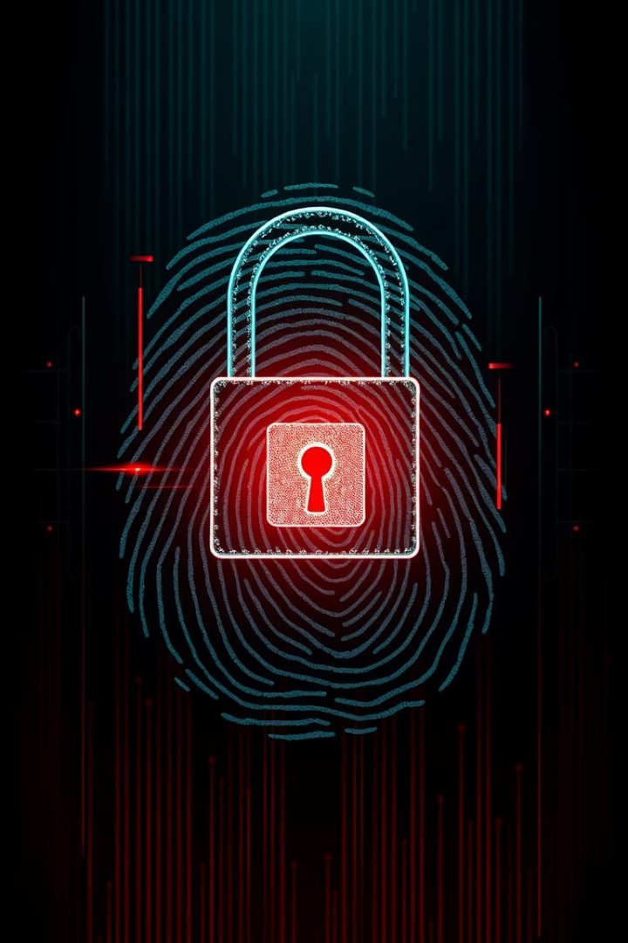
Stay Vigilant, Stay Protected
Continuous Awareness is Key
The fight against SIM card and fingerprint fraud requires continuous vigilance. Staying informed about the latest scam tactics and protective measures is your first line of defense.
Protect Your Biometric Data
Your fingerprints are unique and permanent. Safeguarding this biometric data is paramount to protecting your identity and preventing long-term financial and personal risks.
Report and Collaborate
By promptly reporting suspicious activities and collaborating with authorities, we collectively contribute to a safer digital environment. Your active participation is vital in combating these crimes.

